Slide 1
Adversarial Search
Chapter 5.1-5.3

Slide 2
Games vs. search problems
Search space where agent goals are in conflict.
Typically in games.
If one player wins, the other loses. This element makes it adversial.
"Unpredictable" opponent → specifying a move for every possible opponent reply
Time limits → unlikely to find goal, must approximate

Slide 3
Game search
Game-playing programs developed by AI researchers since the beginning of the modern AI era
  Programs playing chess, checkers, etc (1950s)
Specifics:
  Sequences of player’s decisions we control
  Decisions of other player(s) we do not control
Contingency problem: many possible opponent’s moves must be “covered” by the solution
Opponent’s behavior introduces uncertainty
Rational opponent – maximizes its own utility (payoff) function

Slide 4
Game search
Games are interesting as they are too hard to solve.
Chess has average 35 branches on each move.
Each of the two players typically takes 50 moves.
Search tree has 35¹⁰⁰ nodes i.e 10¹⁵⁴ (too huge)
Game playing involves how to make best possible use of time.
Interesting points to be considered
  What is an optimal move, how to what is the algorithm to find it?
  Technique for choosing a good move when time is limited.
  Pruning allows to ignore portions of search tree that makes no difference.
  Heuristic evaluation function approximates the true utility of a state
  Some games use the information of chance or imperfect information
Games of two players are considered, whom we call MAX and MIN.
  MAX takes the first turn.

Slide 5
Game Search Problem
Game is formally defined as a search problem.
Problem formulation
  Initial state: initial board position + whose move it is
  Players: Which player has the move in the state.
  Actions: legal moves a player can make
  Results (s,a): The transition model that defines the result of a move.
  Goal (terminal test): game over?
  Utility (payoff) function: measures the outcome of the game and its desirability. In Chess we have win(+1), lose(-1) or draw (0).
The initial state, Actions and Results are defined by game tree.
Search objective:
  Find the sequence of player’s decisions (moves) maximizing its utility (payoff)
  Consider the opponent’s moves and their utility

Slide 6


Game tree (2-player, deterministic, turns)

Slide 7
Minimax Algorithm
A simple game like tic-tac-toe is too complex for us to draw the entire game.
We shift to a much simpler game MinMax Game Tree.
How to deal with the contingency problem?
  Assuming the opponent is always rational and always optimizes its behavior (opposite to us), we consider the best opponent’s response
  Then the minimax algorithm determines the best move

Slide 8
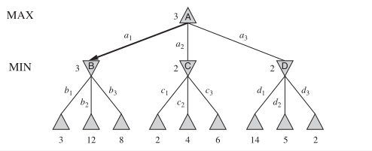
Minimax Game Tree
A simple game like tic-tac-toe is too complex for us to draw the entire game.
We shift to a much simpler game MinMax Game Tree.
MinMax Game tree is commonly used in game theory for explaining decision making.
Max player tries to maximize the score.
Min player tries to minimize the score.
Triangle represent decision nodes. Leaf nodes (bottom) are terminal states.

Slide 9
Minimax Game Tree
What the diagram represents:
MAX and MIN levels:
  The MAX player (top level) tries to maximize the score.
  The MIN player (next level) tries to minimize it (acting as an opponent).
Nodes and edges:
  Triangles represent decision nodes.
  The leaf nodes (bottom) are terminal states with utility values (outcomes of the game).
Evaluation:
  Values propagate upward:
  The MIN nodes pick the minimum value of their children.
  The MAX node picks the maximum among its children.
Arrows:
  Highlight the optimal path chosen by the Minimax algorithm.
  The bold arrow indicates the best move from the MAX perspective.

Slide 10
Minimax Game Tree
Example from your image:
  Node B has children with values 3, 12, 8, so MIN chooses 3.
  Node C has children 2, 4, 6, MIN chooses 2.
  Node D has children 14, 5, 2, MIN chooses 2.
  MAX now chooses the maximum among 3 (from B), 2 (from C), 2 (from D), which is 3.
So, the best move for the MAX player is to choose action a1 leading to node B

Slide 11
Alpha Beta Pruning
Alpha-Beta Pruning is an optimization technique for the Minimax algorithm. It reduces the number of nodes evaluated in the game tree, improving efficiency without affecting the final decision.
Alpha-beta pruning "prunes" (cuts off) branches in the tree that won’t affect the final decision, so they don’t need to be explored.
Two Key Variables:
  Alpha (α): The best value that the MAX player can guarantee so far.
  Beta (β): The best value that the MIN player can guarantee so far.
As we move through the tree:
  At MAX nodes, update α.
  At MIN nodes, update β.
If at any point α ≥ β, we stop exploring that branch (prune it), because it can't influence the final decision.

Slide 12
Alpha Beta Pruning
Applying to Your Game Tree:
Let’s step through the root node A, applying alpha-beta pruning:
Start with α = -∞, β = ∞.
Go to child B (a1):
  At B, evaluate b1 = 3. β = min(∞, 3) = 3.
  Evaluate b2 = 12. β = min(3, 12) = 3.
  Evaluate b3 = 8. β = min(3, 8) = 3.
  Done with B, return 3 to A. Update α = max(-∞, 3) = 3.
Go to child C (a2):
  At C, evaluate c1 = 2. β = min(∞, 2) = 2.
  Before continuing: β = 2 < α = 3, so prune the rest of C (don’t evaluate c2 and c3).
Go to child D (a3):
  At D, evaluate d1 = 14. β = min(∞, 14) = 14.
  Evaluate d2 = 5. β = min(14, 5) = 5.
  Before evaluating d3, β = 5 > α = 3, so we continue.
  Evaluate d3 = 2. β = min(5, 2) = 2.
  Done with D, return 2 to **A`.
Final decision at A: max(3, 2, 2) = 3.

Slide 13

Minimax
Perfect play for deterministic games
Idea: choose move to position with highest minimax value
= best achievable payoff against best play
E.g., 2-ply game: [will go through another eg in lecture]

Slide 14
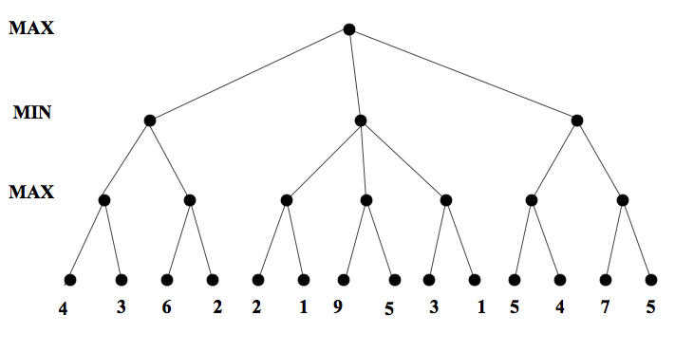
Minimax. Example

Slide 15
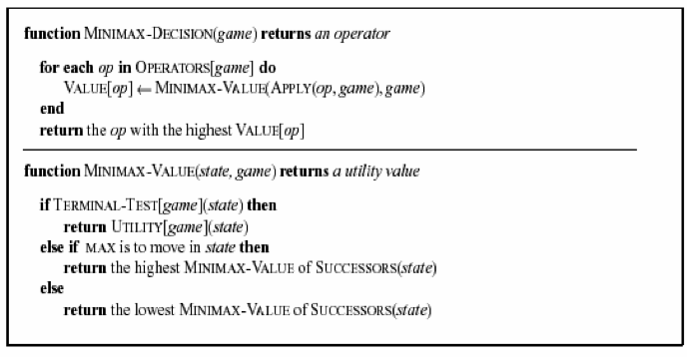

Slide 16
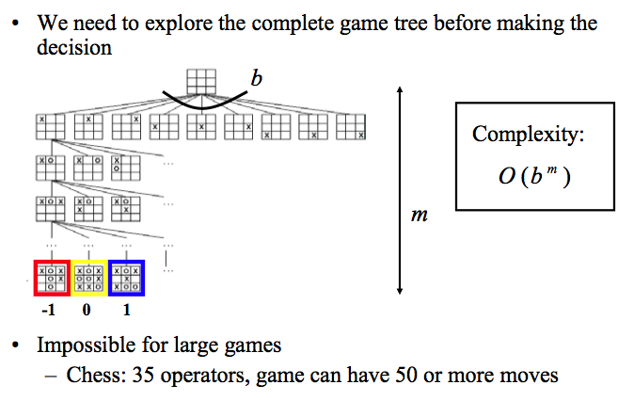
Complexity of the minimax algorithm

Slide 17
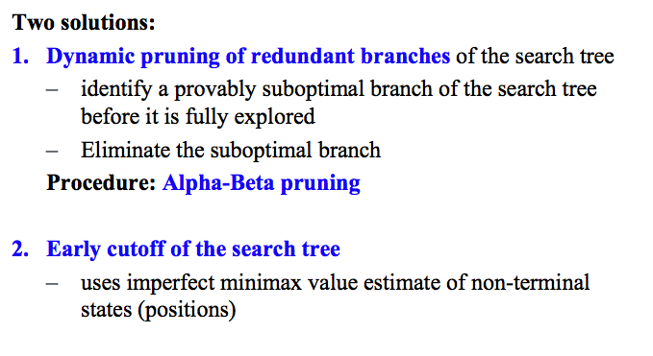
Solution to the complexity problem

Slide 18
Alpha Beta Pruning
Some branches will never be played by rational players since they include sub-optimal decisions for either player
First, we will see the idea of Alpha Beta Pruning
Then, we’ll introduce the algorithm for minimax with alpha beta pruning, and go through the example again, showing the book-keeping it does as it goes along

Slide 19
Alpha beta pruning. Example

Slide 20
Minimax with alpha-beta pruning: The algorithm
Maxv: function called for max nodes
  Might update alpha, the best max can do far
Minv: function called for min nodes
  Might update beta, the best min can do so far
Each tests for the appropriate pruning case
We’ll go through the algorithm on the course website

Slide 21
Algorithm example: alphas/betas shown

Slide 22
Properties of α-β
Pruning does not affect final result
Good move ordering improves effectiveness of pruning
With "perfect ordering," time complexity = O(b^{m/2})
  → doubles depth of search
A simple example of the value of reasoning about which computations are relevant (a form of metareasoning)

Slide 23
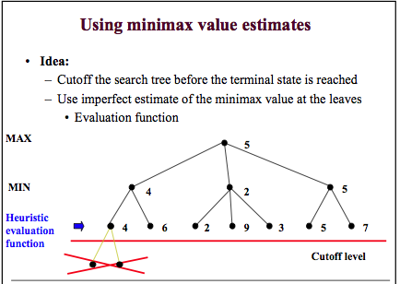

Slide 24
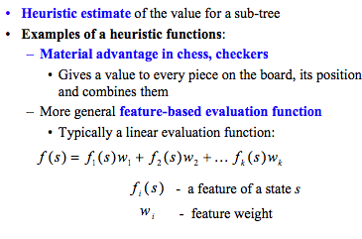
Design of evaluation functions

Slide 25
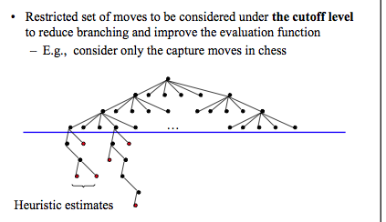
Further extensions to real games

